Slide 1
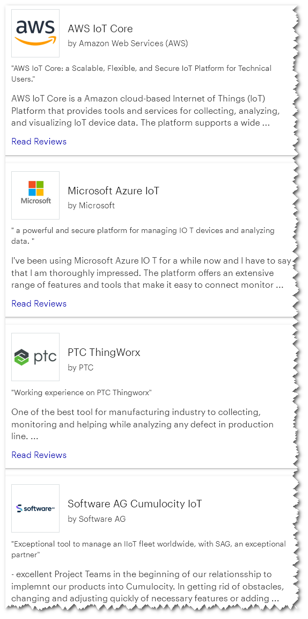

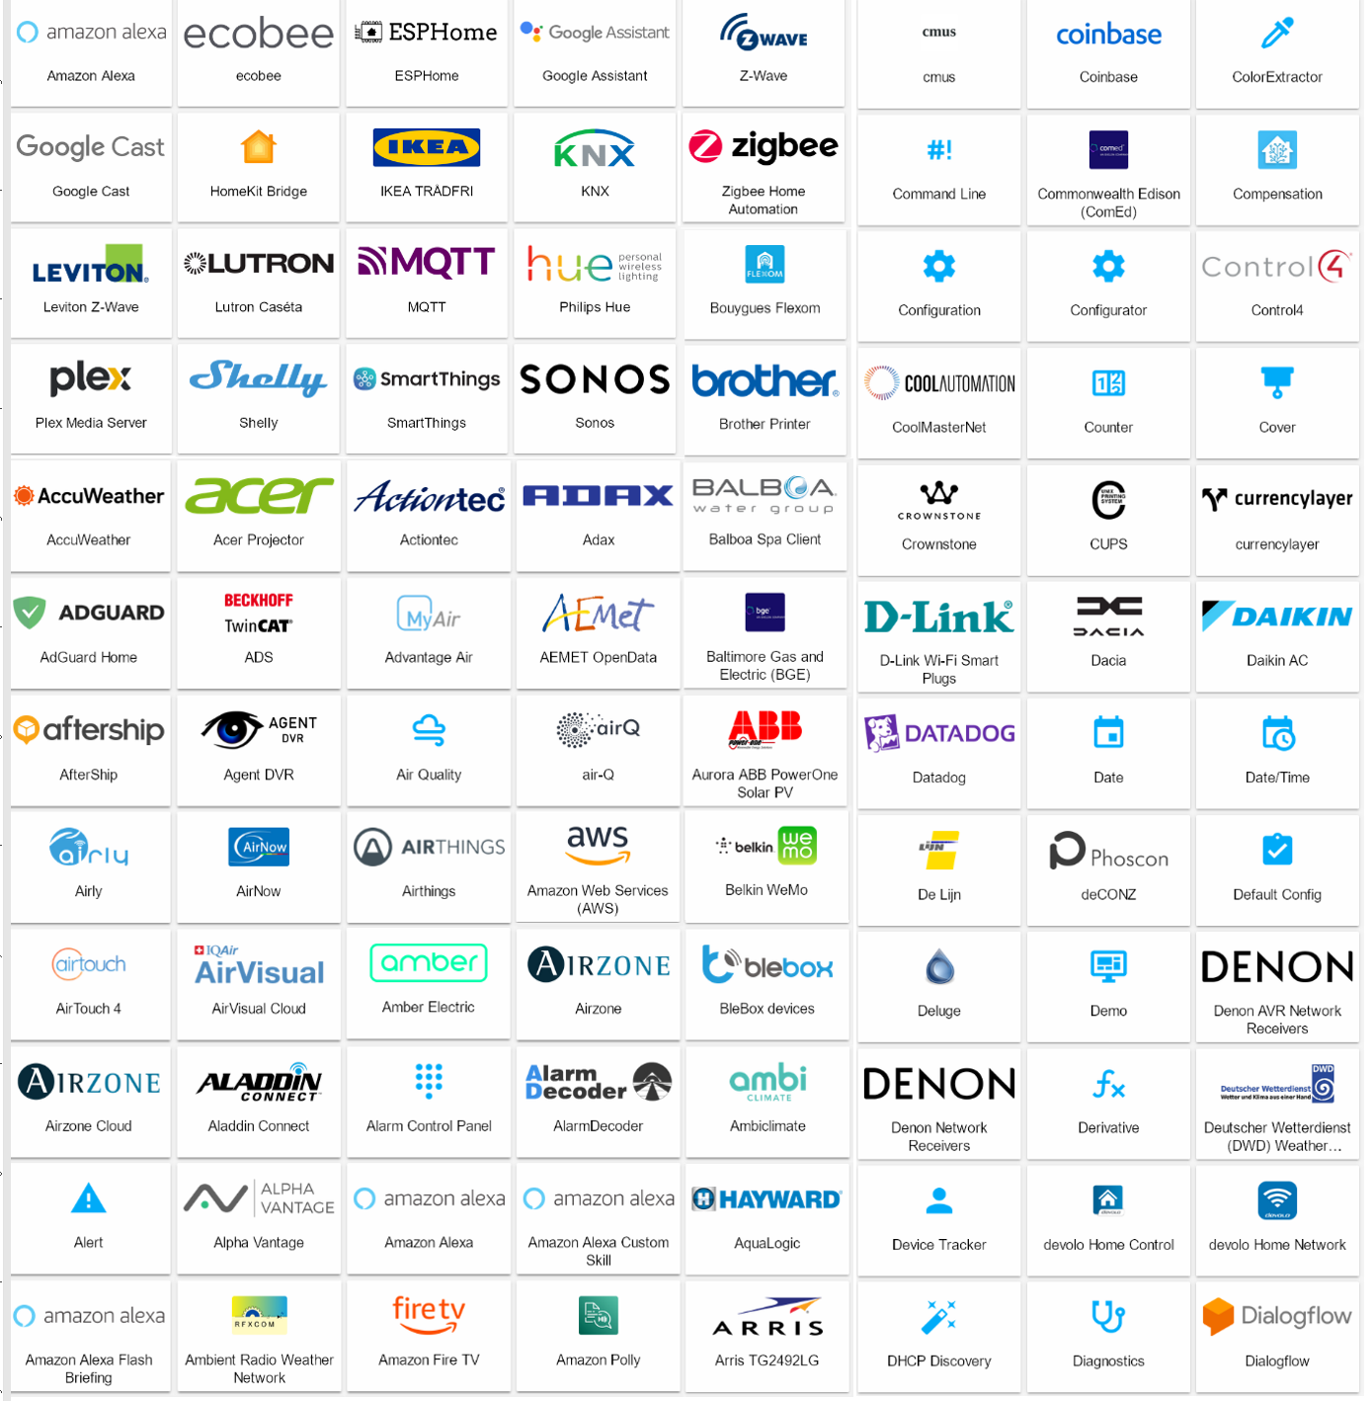


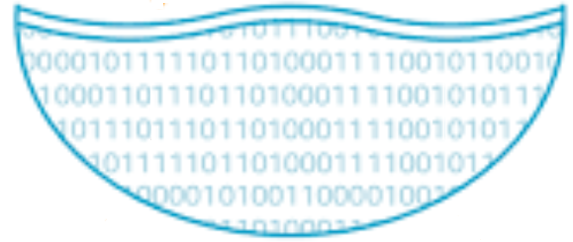





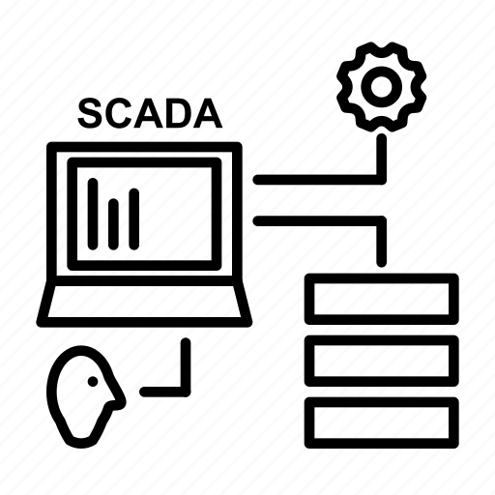





Factory Access IIoT platform
Connected (global) IoT and Industrial IoT platforms and services
IIoT
IoT
Machine learning
…
…
Data Lake
Fact-IoT platform
Fact-IoT platform
Data history
Web connection
extreme compression and speed
Basic Analytics
Fact-IoT distribution service
Fact-IoT distribution service
Fact-IoT distribution service
…
Data validation
DMS-BI
…
thousands
Industrial and business solutions – on-premise and as service
Every system sees the data of all others
Reports
…
PLC / HMI
SCADA
EMS
MES
CMMS
DMS
Mini- SCADA
Supervisory Control and Data Acquisition
Energy Management
Manufacturing Execution System
Maintenance Management
Data Management Studio
Business Solutions
…
many hundreds

